Slide 1
McArthur Island Flood Protection
Design proposal
PREPARED BY Hannah Clark

Slide 2
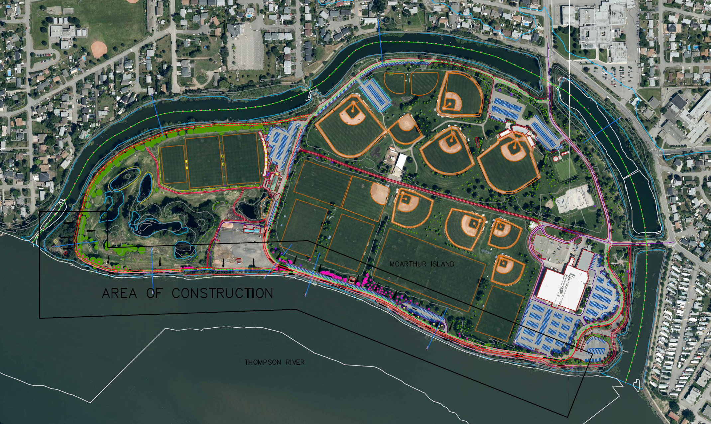
Mcarthur Island overview
Photo: City of Kamloops; Drawing: Author Generated
McArthur Island is home to many sports fields and facilities. The annual flooding causes problems with access as well as damage to existing facilities. This project is focused on developing flood protection along the south side of the park as well as changes to the slough for more regional flood mitigation.

Slide 3
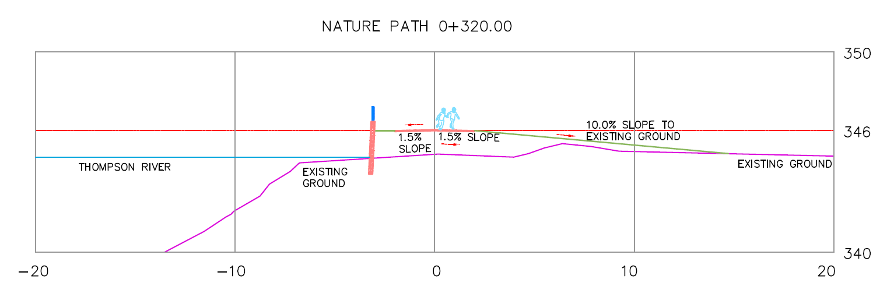
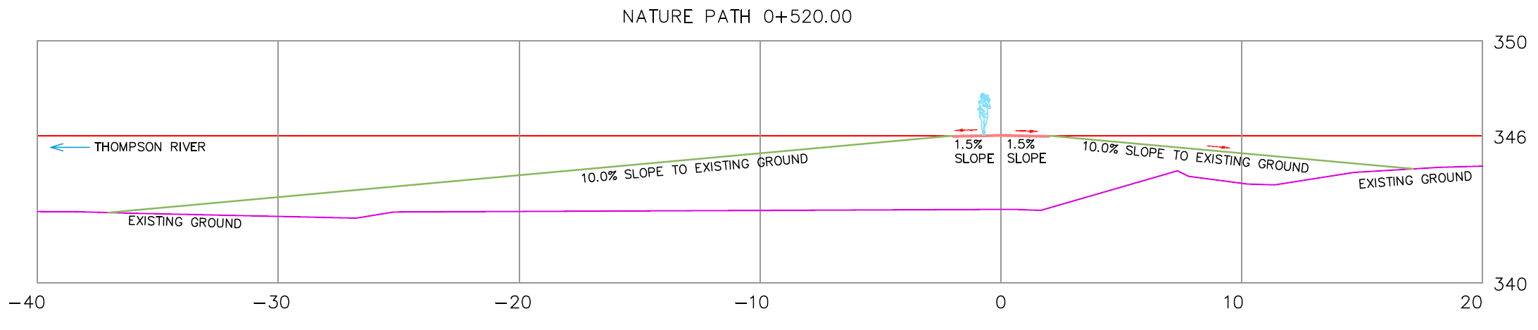
Nature Path - Cross Sections
Source: Author Generated
Source: Author Generated
Cross sections of design changes to existing nature path including a raise in elevation of the path, a concrete retaining wall where necessary, and a slope down to existing ground.

Slide 4
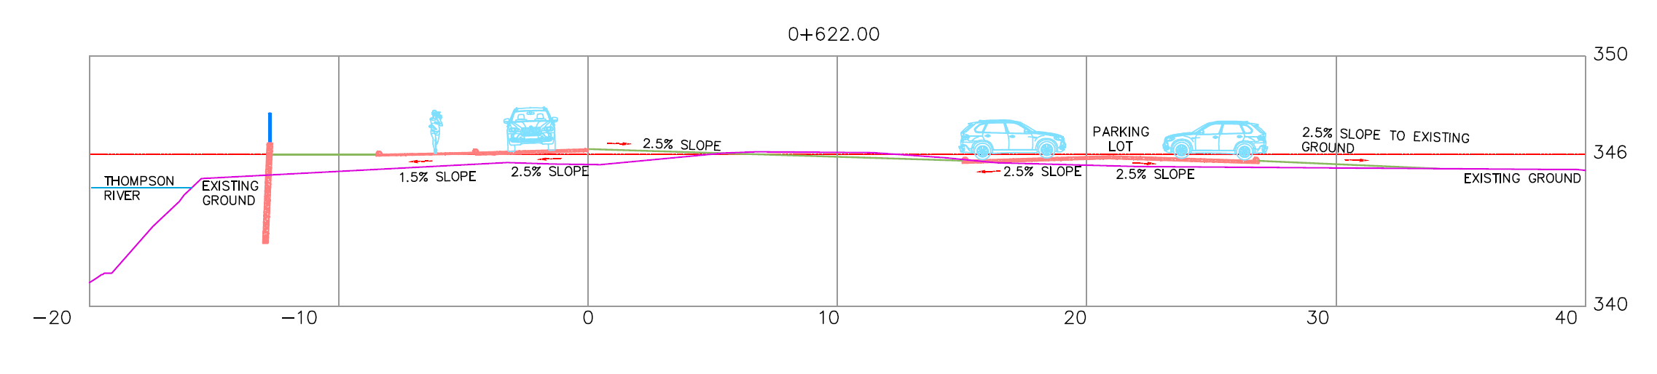
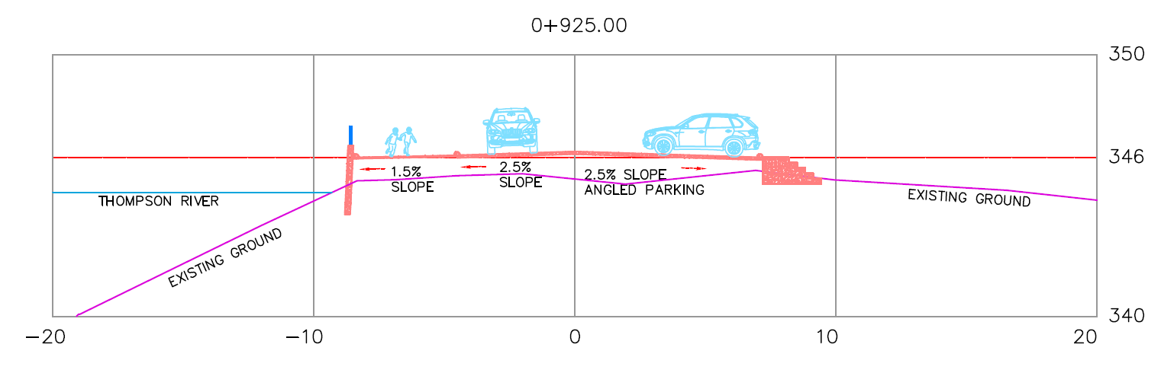
Roadway – Cross Sections
Source: Author Generated
Source: Author Generated
Cross sections of roadways and parking areas that include a raise in elevation, concrete retaining walls and slopes or stairs to existing ground.

Slide 5
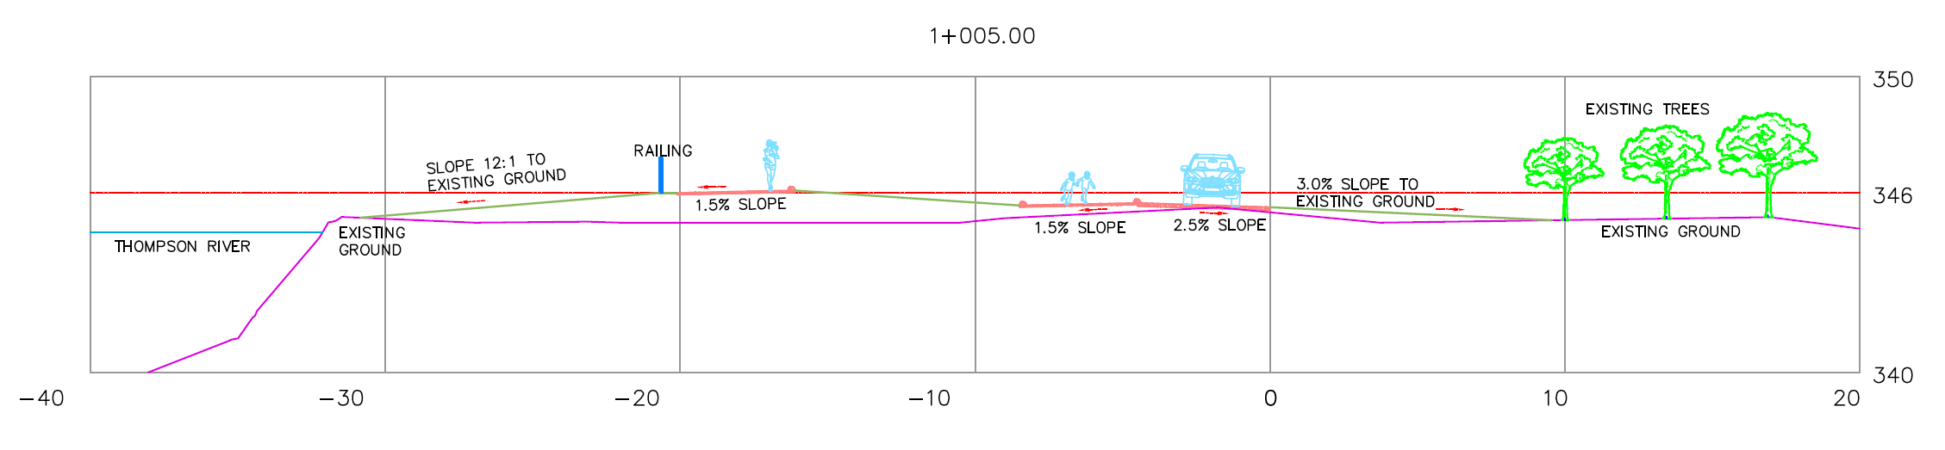
Roadway – Cross Sections
Source: Author Generated
Cross sections of roadways and parking areas that include a raise in elevation and slopes to existing ground.

Slide 6
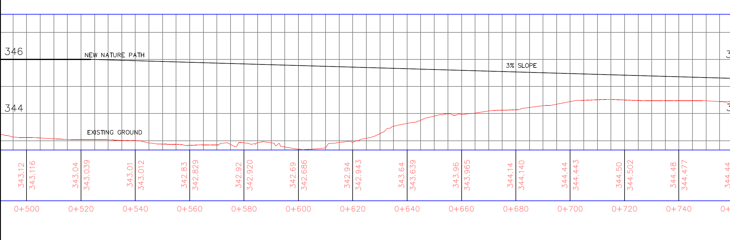
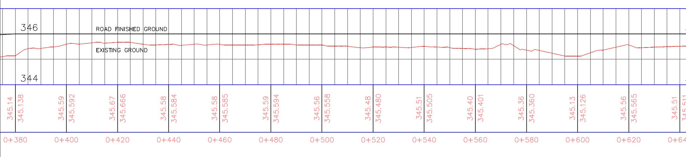
Profile Views
Source: Author Generated
Source: Author Generated
Profile views illustrate the change in elevation proposed for the existing nature path and roadway.

Slide 7
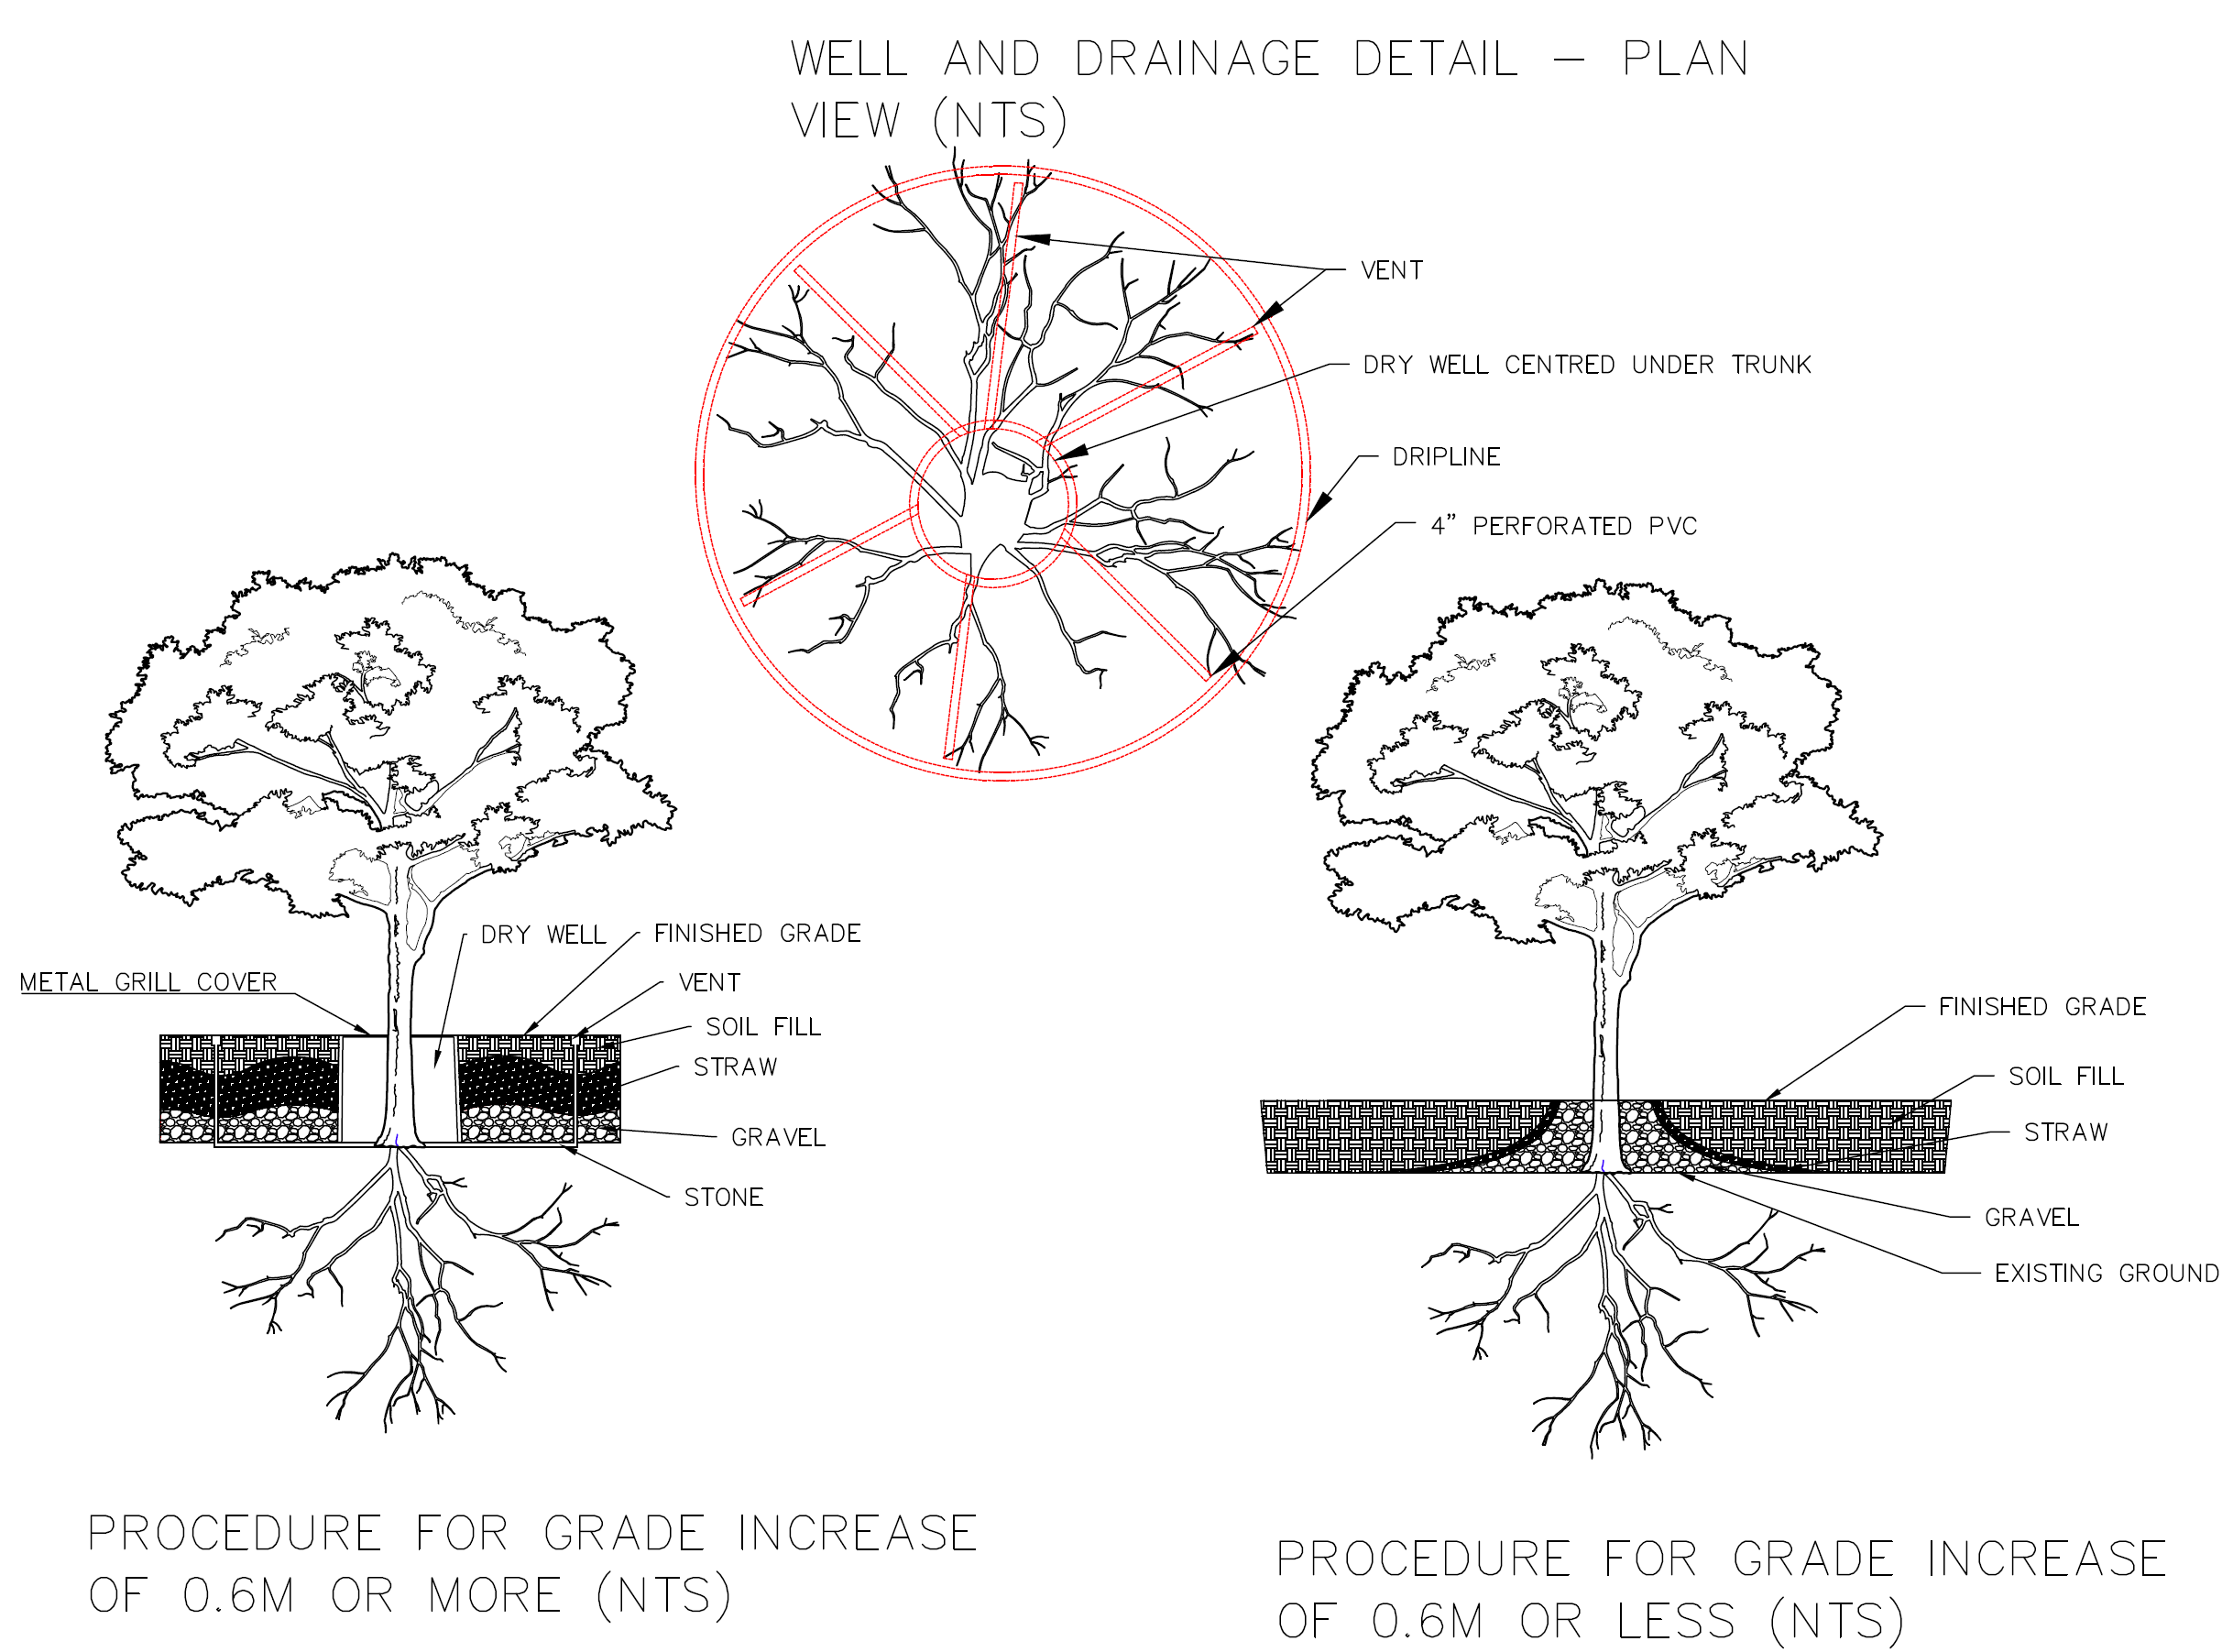
Details – Existing Tree Protection
Source: Author Generated from Information Found: https://aggie-horticulture.tamu.edu/earthkind/landscape/protecting-trees/
Tree protection procedures in the event of a elevation/grade increase.

Slide 8
Plan View - Slough
Photo: City of Kamloops; Drawing: Author Generated
Design includes an increase in depth of the slough by one metre to allocate space for safe flood water storage.

Slide 9
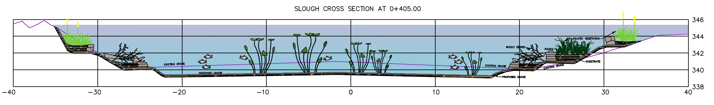
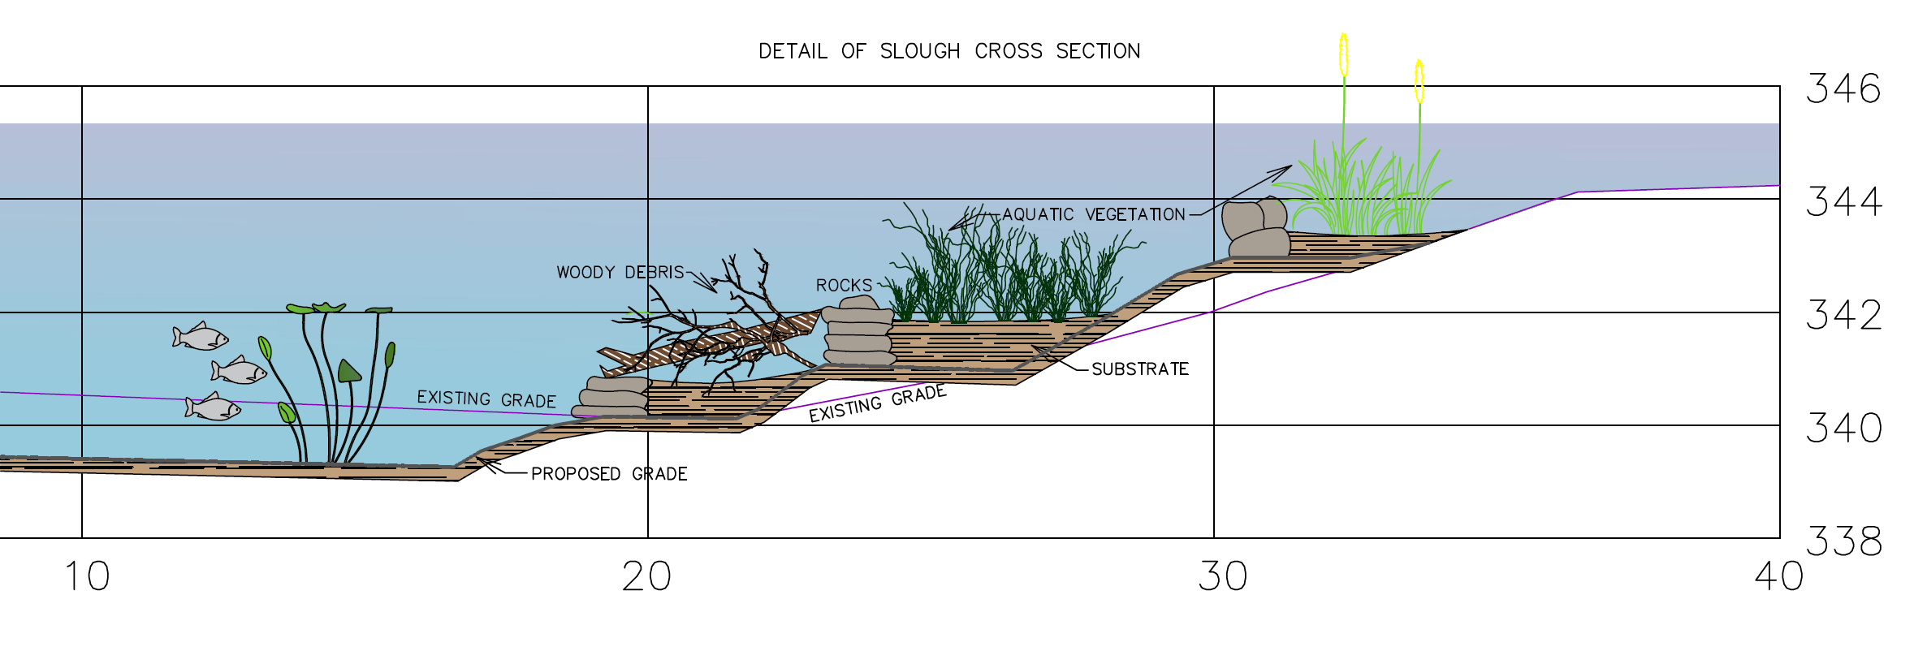
Slough – Cross Section
Source: Author Generated
Source: Author Generated
The cross section illustrates what the one metre grade change for the slough. In the detail drawing, the rehabilitation of the wildlife habitat is outlined.

